Slide 1
CS2106 Tutorial 7
Contiguous memory allocation

Slide 2
Regarding midterm
some of the questions that you’ve raised during previous tutorial are still being discussed; won’t be finalized until grading is finished
Refer to the official marking scheme that they will be releasing soon
if any further questions can ask me separately

Slide 3
Q1
fixed partitioning

Slide 4
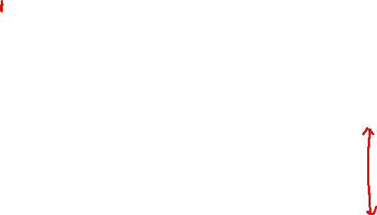
1a
200 | 400 | 600 | 500 | 300 | 250
Four processes of sizes
357 KB
210 KB
468 KB
491 KB
in that order.
First Fit

Slide 5

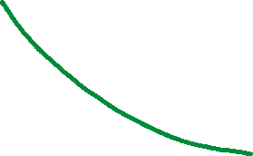

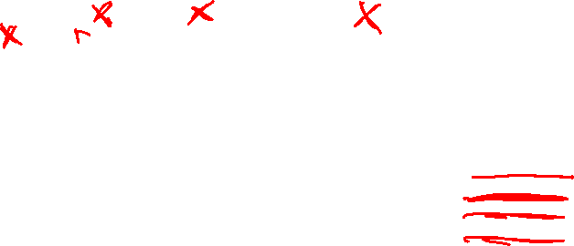

1a
200 | 400 | 600 | 500 | 300 | 250
Four processes of sizes
357 KB
210 KB
468 KB
491 KB
in that order.
First Fit

Slide 6
1b
200 | 400 | 600 | 500 | 300 | 250
Four processes of sizes
357 KB
210 KB
468 KB
491 KB
in that order.
Best Fit

Slide 7

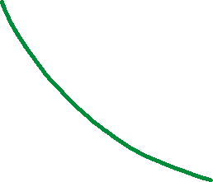


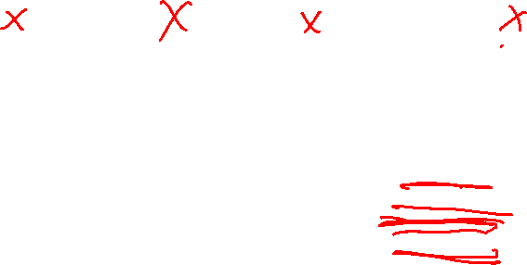
1b
200 | 400 | 600 | 500 | 300 | 250
Four processes of sizes
357 KB
210 KB
468 KB
491 KB
in that order.
Best Fit

Slide 8
1c
200 | 400 | 600 | 500 | 300 | 250
Four processes of sizes
357 KB
210 KB
468 KB
491 KB
in that order.
Worst Fit

Slide 9
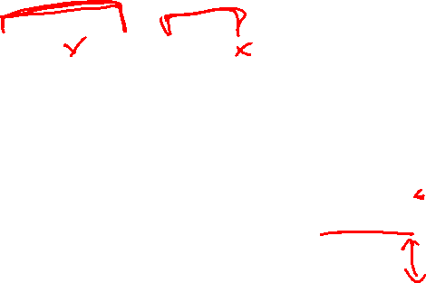




1c
200 | 400 | 600 | 500 | 300 | 250
Four processes of sizes
357 KB
210 KB
468 KB
491 KB
in that order.
Worst Fit

Slide 10
1 | Memory efficiency & Runtime
In this particular example,
Best Fit Algorithm turns out to be the best in terms of memory efficiency.
However, that does not need to hold true in general.
Regarding the runtime, Best Fit and Worst Fit must go through the entire list (O(N)) to find the best (worst) candidate.
First Fit has the best runtime as the search stops as soon as the first free hole that accommodates the request is available.

Slide 11
Q2
dynamic partitioning

Slide 12
2
In the lecture, we used linked list to store partition information under the dynamic allocation scheme.
One common alternative is to use bitmap (array of bits) instead.
Basic idea: A single bit represents the smallest allocatable memory space,
0 = free, 1 = occupied.
Use a collection of bits to represent the allocation status of the whole memory space.
As a tiny example, suppose the memory size is 16KB and the smallest allocatable unit is 1KB. We need 16 bits (2 bytes) to keep track of the allocation status:
0 | 0 | 0 | 0 | 0 | 0 | 0 | 0
0 | 0 | 0 | 0 | 0 | 0 | 0 | 0

Slide 13
allocatable unit != partition
1kb = smallest allocatable unit
empty partition
0 | 0 | 0 | 0 | 0 | 0 | 0 | 0
0 | 0 | 0 | 0 | 0 | 0 | 0 | 0

Slide 14
allocatable unit != partition
When allocating Process A of size 6KB
1kb = smallest allocatable unit
empty partition
0 | 0 | 0 | 0 | 0 | 0 | 0 | 0
0 | 0 | 0 | 0 | 0 | 0 | 0 | 0

Slide 15
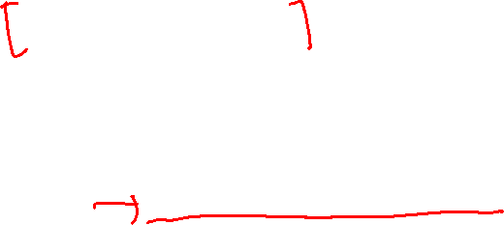
allocatable unit != partition
After allocating Process A of size 6KB
1kb = smallest allocatable unit
empty partition
1 | 1 | 1 | 1 | 1 | 1 | 0 | 0
0 | 0 | 0 | 0 | 0 | 0 | 0 | 0

Slide 16



allocatable unit != partition
Meaning of smallest allocatable unit?
For process B of size 1.7KB → occupies 2KB on ram
1kb = smallest allocatable unit
empty partition
1 | 1 | 1 | 1 | 1 | 1 | 0 | 0
0 | 0 | 0 | 0 | 0 | 0 | 0 | 0

Slide 17

allocatable unit != partition
Meaning of smallest allocatable unit?
For process B of size 1.7KB → occupies 2KB on ram
1kb = smallest allocatable unit
empty partition
1 | 1 | 1 | 1 | 1 | 1 | 1 | 1
0 | 0 | 0 | 0 | 0 | 0 | 0 | 0

Slide 18
2a | Pseudocode to allocate by first fit
The key observation is that
the bits cannot be accessed directly as if it is an array.
Bitwise operations (logical AND / OR and shifting) are needed in order to retrieve a bit.
Bit manipulation is the main overhead of using bitmap.
For ease of discussion, the pseudo codes below are presented as if array indexing is provided for bitmap.

Slide 19
2a | Pseudocode to allocate by first fit
Start ← 0
Start ← Location (index) of the first '0' in the bitmap after Start
If there are X consecutive zeroes, mark [Start…Start+X-1] as 1, success!
Else Start ←The first '1' in the bitmap after Start, repeat step 2.
Stop when bitmap is exhausted.

Slide 20
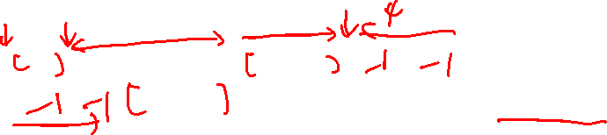
2a | Pseudocode to allocate by first fit
Start ← 0
Start ← Location (index) of the first '0' in the bitmap after Start
If there are X consecutive zeroes, mark [Start…Start+X-1] as 1, success!
Else Start ←The first '1' in the bitmap after Start, repeat step 2.
Stop when bitmap is exhausted.
1 | 0 | 0 | 0 | 1 | 1 | 0 | 0
0 | 0 | 1 | 1 | 0 | 0 | 0 | 0
eg. allocate process D of size 4KB

Slide 21

2b | Pseudocode to deallocate
Straightforward.
Mark [Y… Y+X-1] as 0. Done!
1 | 0 | 0 | 0 | 1 | 1 | 0 | 0
0 | 0 | 1 | 1 | 0 | 0 | 0 | 0

Slide 22

2c | Pseudocode to merge free spaces
Straightforward.
No need to do anything. Automatic
After freeing the process, adjacent free spaces now appear contiguous
1 | 0 | 0 | 0 | 1 | 1 | 0 | 0
0 | 0 | 1 | 1 | 0 | 0 | 0 | 0

Slide 23
Q3
buddy system

Slide 24
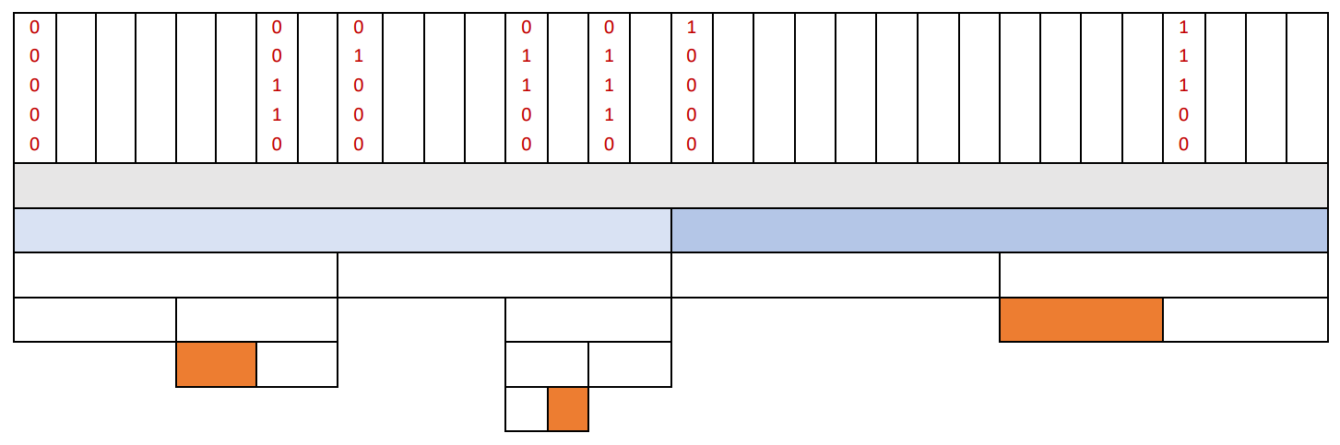
32 bytes
Memory addresses of free blocks
[a] = 00000
[b] = 00110
[c] = 01000
[d] = 01100
[e] = 01110
[f] = 10000
[g] = 11100

Slide 25
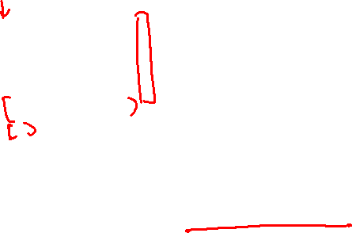
32 bytes
Memory addresses of free blocks
[a] = 00000
[b] = 00110
[c] = 01000
[d] = 01100
[e] = 01110
[f] = 10000
[g] = 11100
How big can free block [a] be?
depends on the address of next free block, [b]

Slide 26
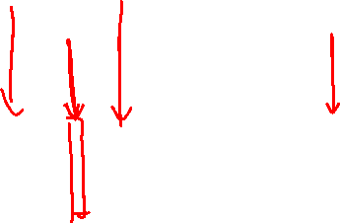
32 bytes
Memory addresses of free blocks
[a] = 00000
[b] = 00110
[c] = 01000
[d] = 01100
[e] = 01110
[f] = 10000
[g] = 11100
depends on the address of next free block, [b]
the address [b] means that the original block was divided (1) to (4) times

Slide 27
32 bytes

Slide 28
32 bytes

Slide 29
32 bytes

Slide 30
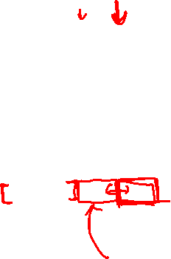

32 bytes
another free block starts here
means that this block is occupied
why? we assumed that we merged all free buddy bocks
possible size range of block [a]

Slide 31
32 bytes
max free space == min allocated memory

Slide 32
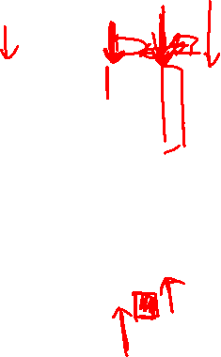
32 bytes

Slide 33
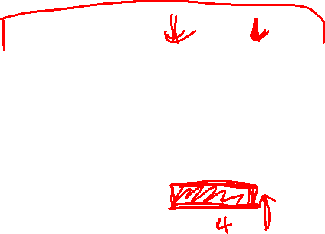
32 bytes

Slide 34

32 bytes
Allocated memory regions are 00100 (size = 2 bytes), 01101 (size = 1 byte), 11000 (size = 4 bytes)
Total memory allocated = 7 bytes.
Any other answer would not be the minimum possible memory allocation.

Slide 35
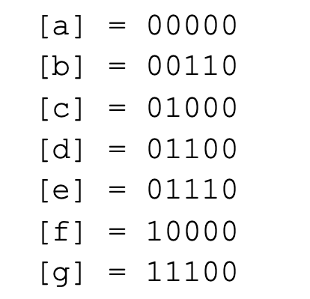
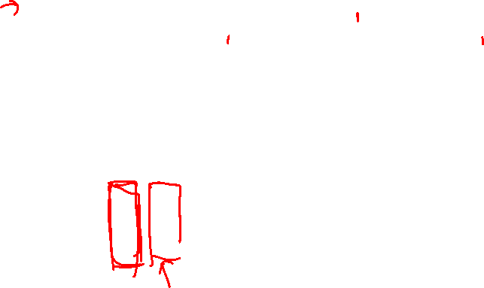
*****
Allocated
Free
0****
1****
Splitted
00***
01***
10***
11***
000**
001**
010**
011**
110**
111**
0010*
0011*
0110*
0111*
01100
0110
1

Slide 36
Q4
bookkeeping information

Slide 37
4 | Representations
Free space = 16MB = 2^24 bytes
Integer representation used for
starting address
size of partition
pointer to another address
4 bytes each
Boolean flag if partition is occupied
1 byte each

Slide 38

4a | Fixed size partitioning
Free space = 16MB = 2 ^ 24 bytes
 |  |  |  |  |  | ….
Each partition has size = 4KB = 2^12 bytes

Slide 39
4a | Fixed size partitioning
Free space = 16MB = 2 ^ 24 bytes
 |  |  |  |  |  | ….
Each partition has size = 4KB = 2^12 bytes
no of partitions = 2^24 / 2^12 = 2^12
array of boolean flags to represent status of each partition →
2¹² * 1 byte = 2² * 2¹⁰ bytes = 4kb

Slide 40
4b | Dynamic size partitioning (LinkedList)
Free space = 16MB = 2 ^ 24 bytes
 |  |  |  |  |  | ….
Smallest request has size = 1KB = 2^10 bytes

Slide 41
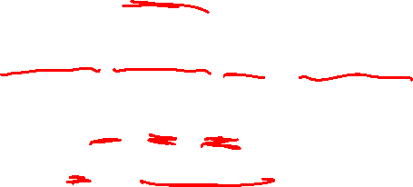
4b | Dynamic size partitioning (LinkedList)
Free space = 16MB = 2 ^ 24 bytes
 |  |  |  |  |  | ….
Smallest request has size = 1KB = 2^10 bytes
node = {Start Address, Partition Size, Status, Next Node Pointer}
size of a node = 4 + 4 + 1 + 4 = 13 bytes
max no of nodes = 2^24 / 2^10 = 2¹⁴
max overhead = 13 * 2¹⁴ = 212992 bytes

Slide 42
4b | Dynamic size partitioning (LinkedList)
Free space = 16MB = 2 ^ 24 bytes
 |  |  |  |  |  | ….
Smallest request has size = 1KB = 2^10 bytes
node = {Start Address, Partition Size, Status, Next Node Pointer}
size of a node = 4 + 4 + 1 + 4 = 13 bytes
max no of nodes = 2^24 / 2^10 = 2¹⁴
min overhead = 13 bytes (when the whole partition is free, only one node is needed

Slide 43

4b | Dynamic size partitioning (LinkedList)
Free space = 16MB = 2 ^ 24 bytes
 |  |  |  |  |  | ….
Smallest request has size = 1KB = 2^10 bytes
alternative linked list:
node = {Start Address, Partition Size, Status, Next Node Pointer}
size of a node = 4 + 4 + 4 = 12 bytes
max no of nodes = 2^24 / 2^10 = 2¹⁴
max overhead = 12 * 2¹⁴ = 196,608 bytes

Slide 44
4c | Dynamic size partitioning (bitmap)
Free space = 16MB = 2 ^ 24 bytes
 |  |  |  |  |  | ….
Smallest request has size = 1KB = 2^10 bytes

Slide 45

4c | Dynamic size partitioning (bitmap)
Free space = 16MB = 2 ^ 24 bytes
 |  |  |  |  |  | ….
Smallest request has size = 1KB = 2^10 bytes
1 bit is used to represent if an allocation unit is free or occupied
size of bitmap = (2²⁴ / 2¹⁰) * 1 bit = 2¹⁴ bits = 2¹⁴ / bytes = 2¹¹ bytes

Slide 46
Optional

Slide 47
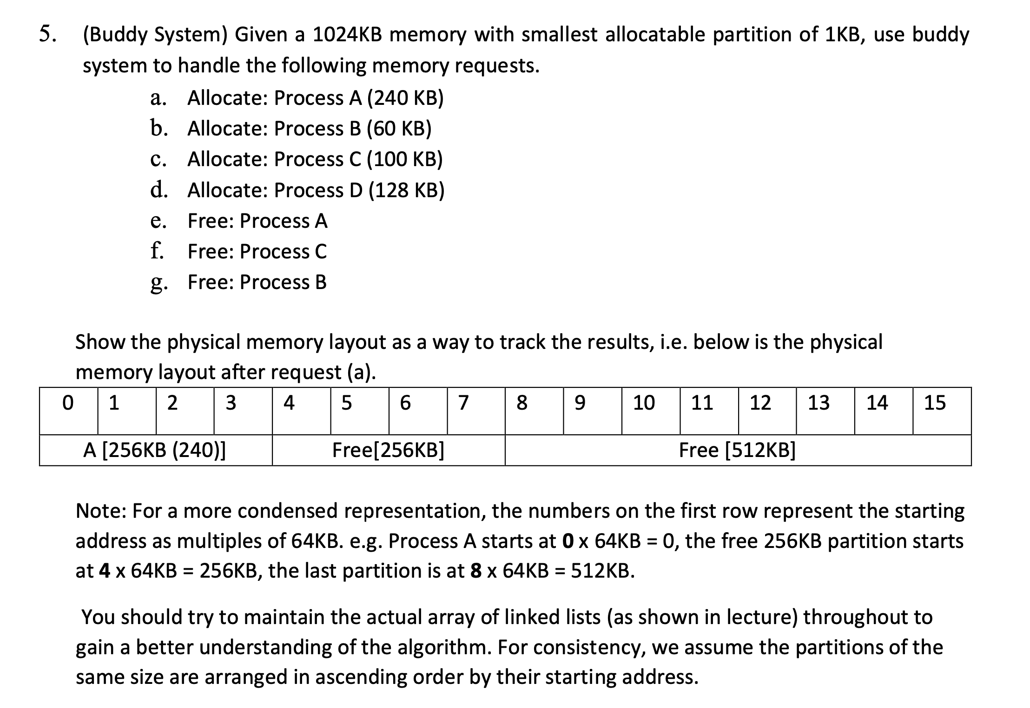

Slide 48
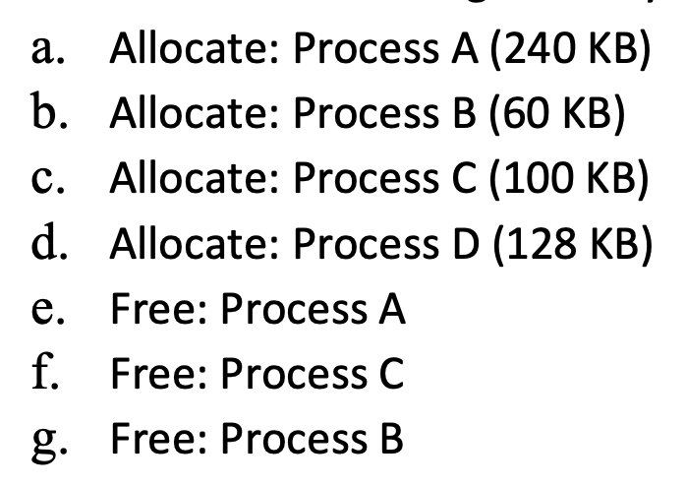
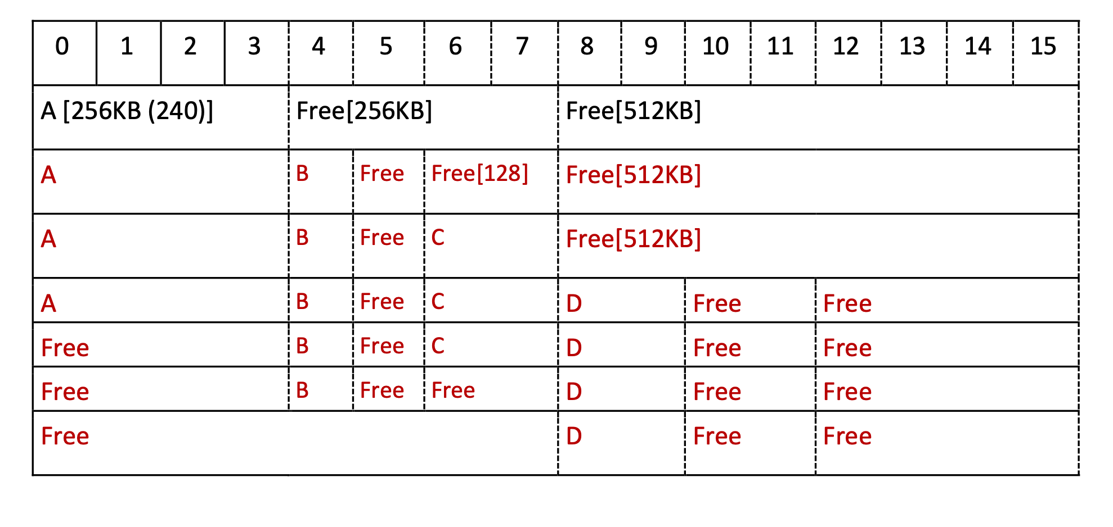
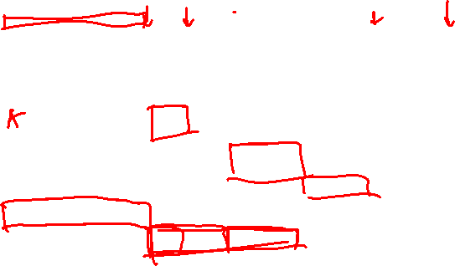

Slide 49
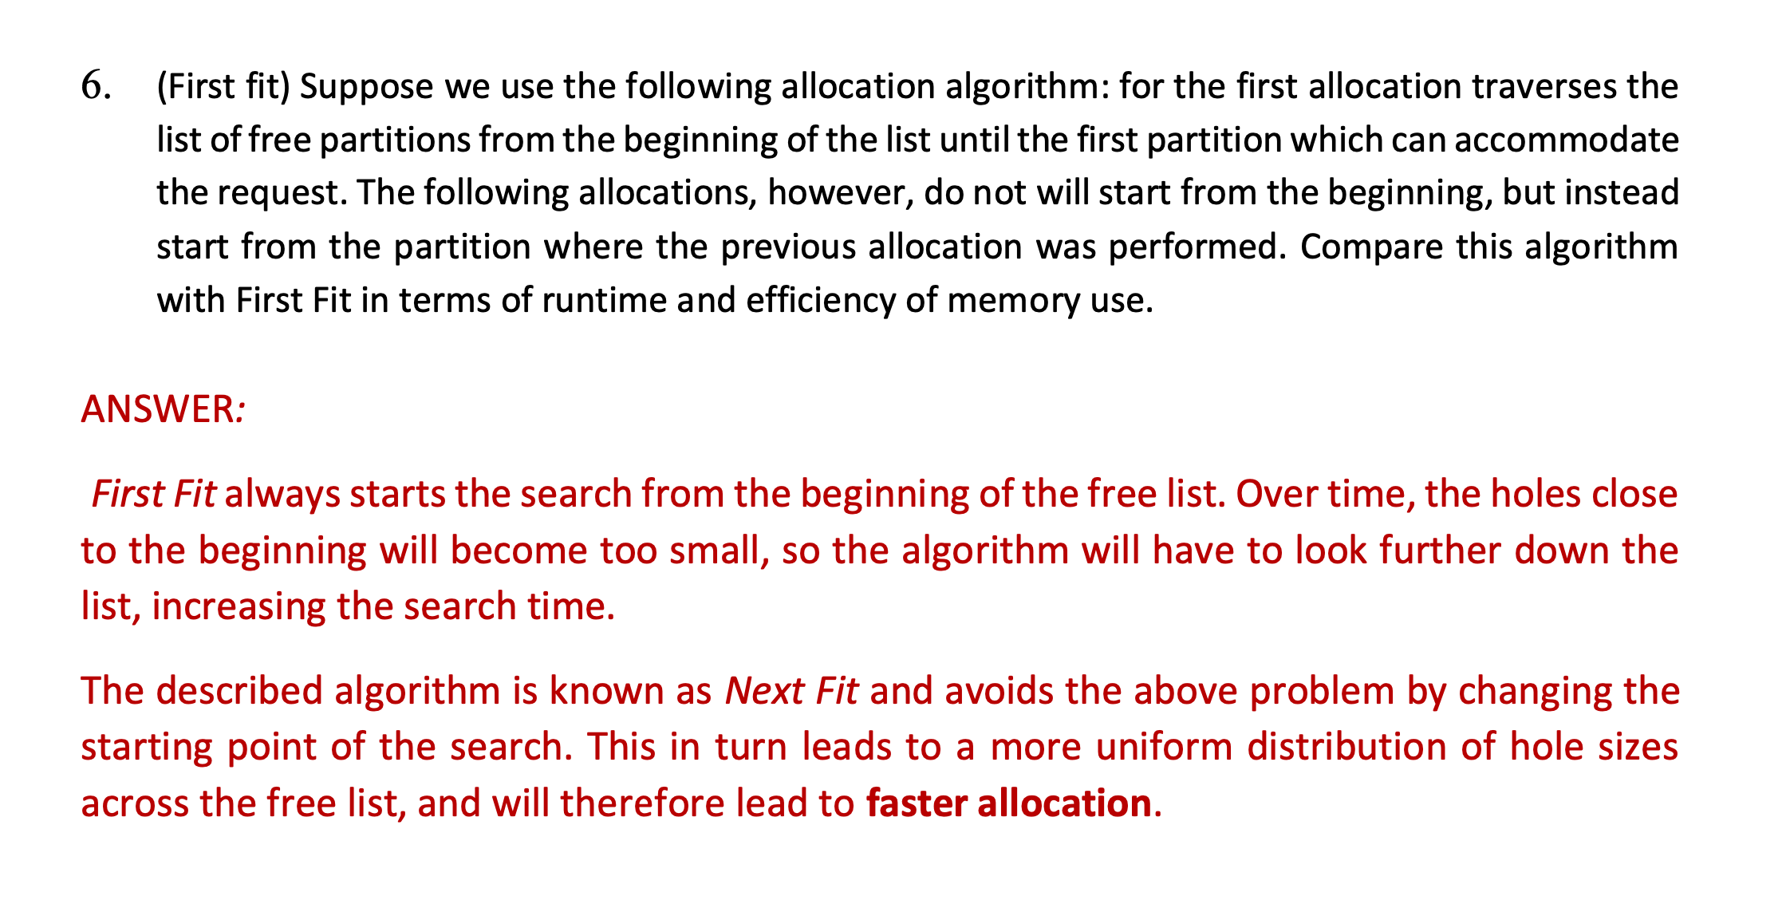

Slide 50
Thank you!

